Slide 1
Predicting Thermodynamic Cloud Phases: The Role of Machine Learning
Carlandra Harris (Alabama State University)

Slide 2
Introduction
Accurately predicting cloud phases is crucial for refining cloud models and understanding Earth's energy balance. The DOE's ARM facility produces the "thermodynamic cloud phase" product from Alaska's north slope instruments. We correct algorithmic errors due to instrument or algorithm failures and apply a random forest model to evaluate if these corrections improve cloud phase prediction accuracy.
Notes:
-talk about cloud phase
-different phases of a cloud
-

Slide 3
Objective
Correct algorithmic errors in the "thermodynamic cloud phase" product derived from ARM data.
Enhance the quality and reliability of cloud phase data for climate modeling.
Apply a random forest machine learning model to predict cloud phases using corrected data.
Evaluate the performance improvement of the random forest model compared to the original data.
Contribute to advancements in understanding Earth's energy budget through more accurate cloud phase predictions.

Slide 4
Hypothesis Question
Can correcting algorithmic errors in the “thermodynamic cloud phase” product and applying a random forest machine learning model improve the accuracy of cloud phase prediction compared to the original data?

Slide 5
Experiment Design
Talk about the use of random forest machine learning method
Describe the training data , validation data, and testing data
Train/validation: 2 months of data(Jan and Feb) 40,000 pixels used for training and 10,000 for validation
Testing: 8 days worth of data seen with plot viewer
Input data-raw instrument data(RADAR, LIDAR, TEMP). There were 9 total
Output data-cloud phase value added product(ICE, LIQUID, DRIZZLE,ETC.). There were 8 classes
I corrected when the cloud phases were miss labeled
Cloud phase was produced using an algorithm(sometimes failed)
Trained the random forest model on original data and corrected data seen how well it predicted
Think of someway to express this in a diagram

Slide 6
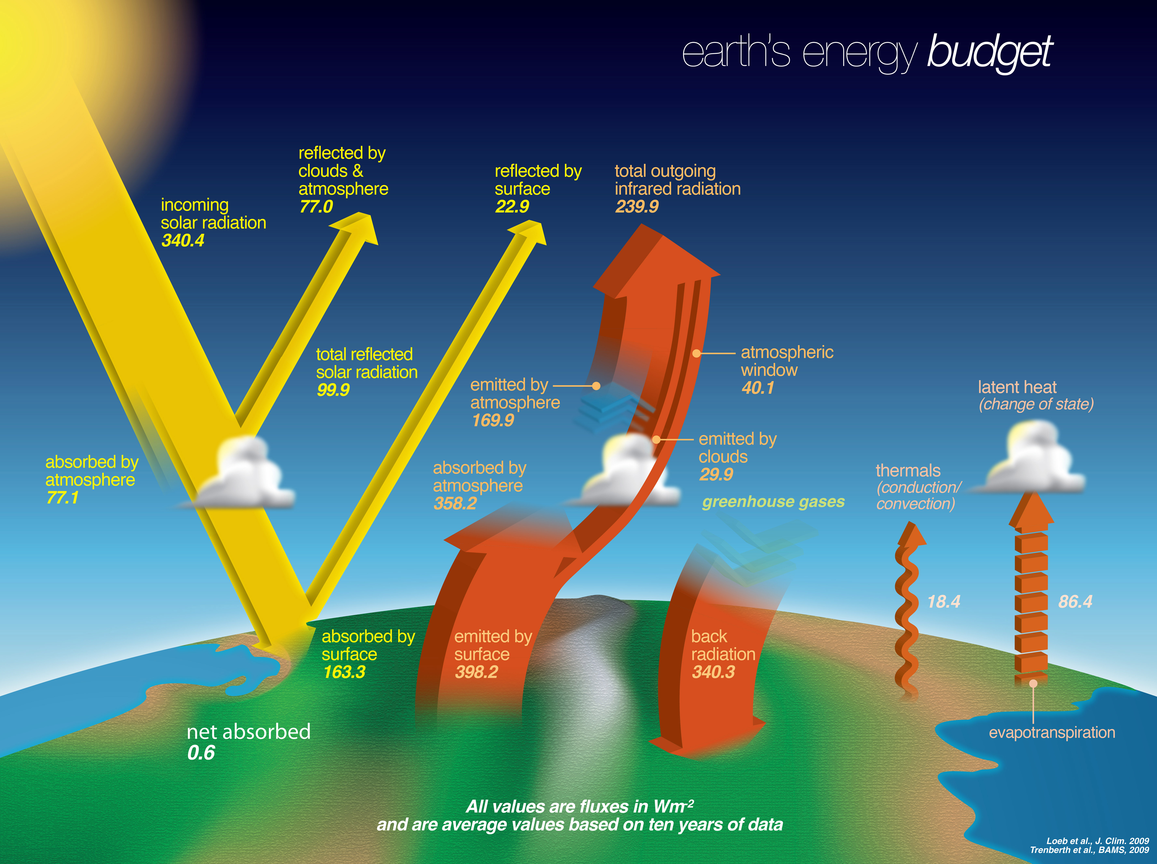
Energy budget
Notes:
-Energy in from the sun and energy out. Clouds play a role in that

Slide 7
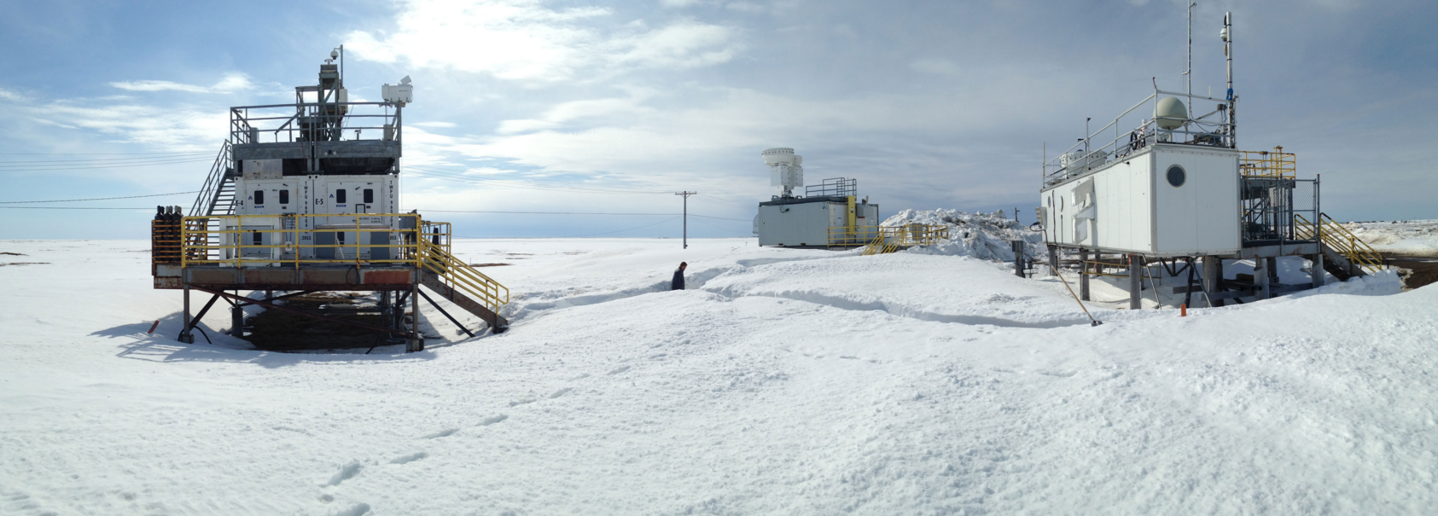
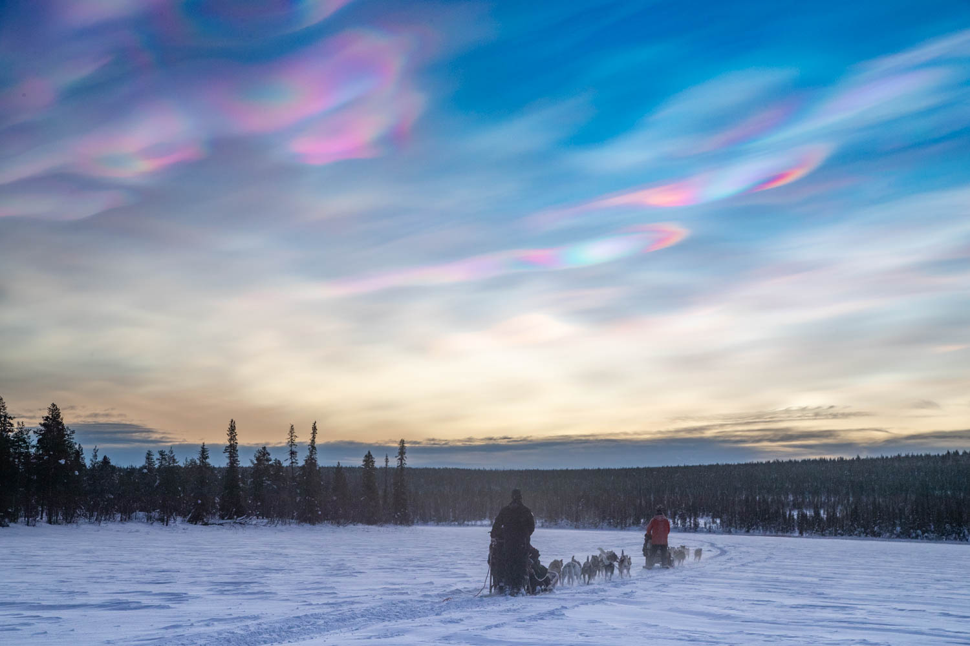
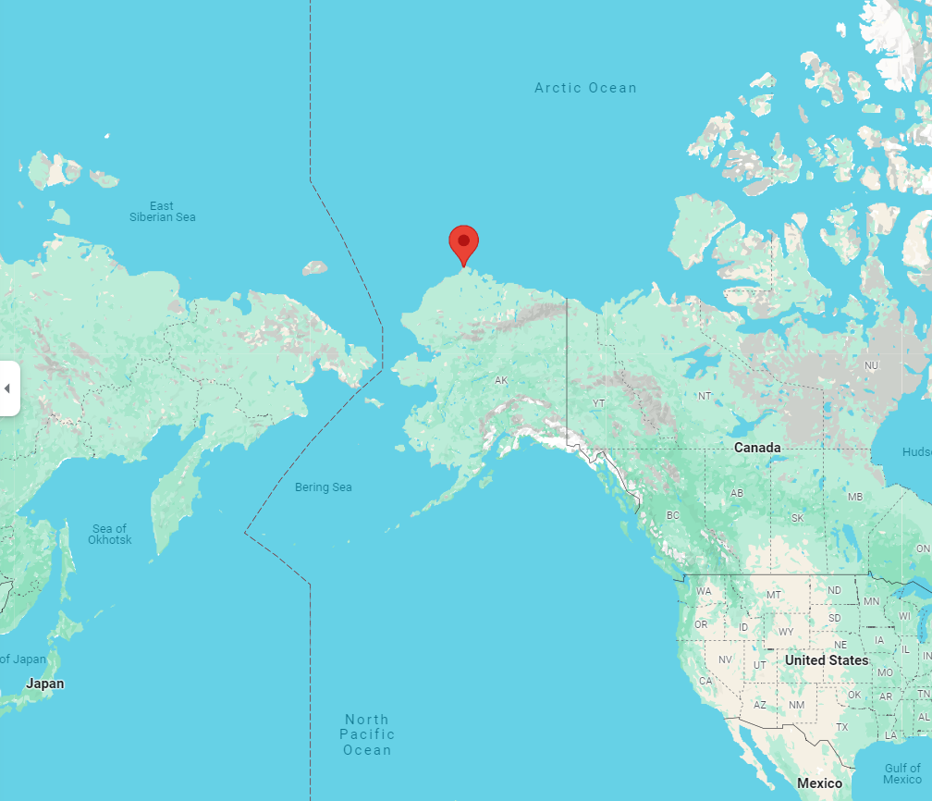

Slide 8
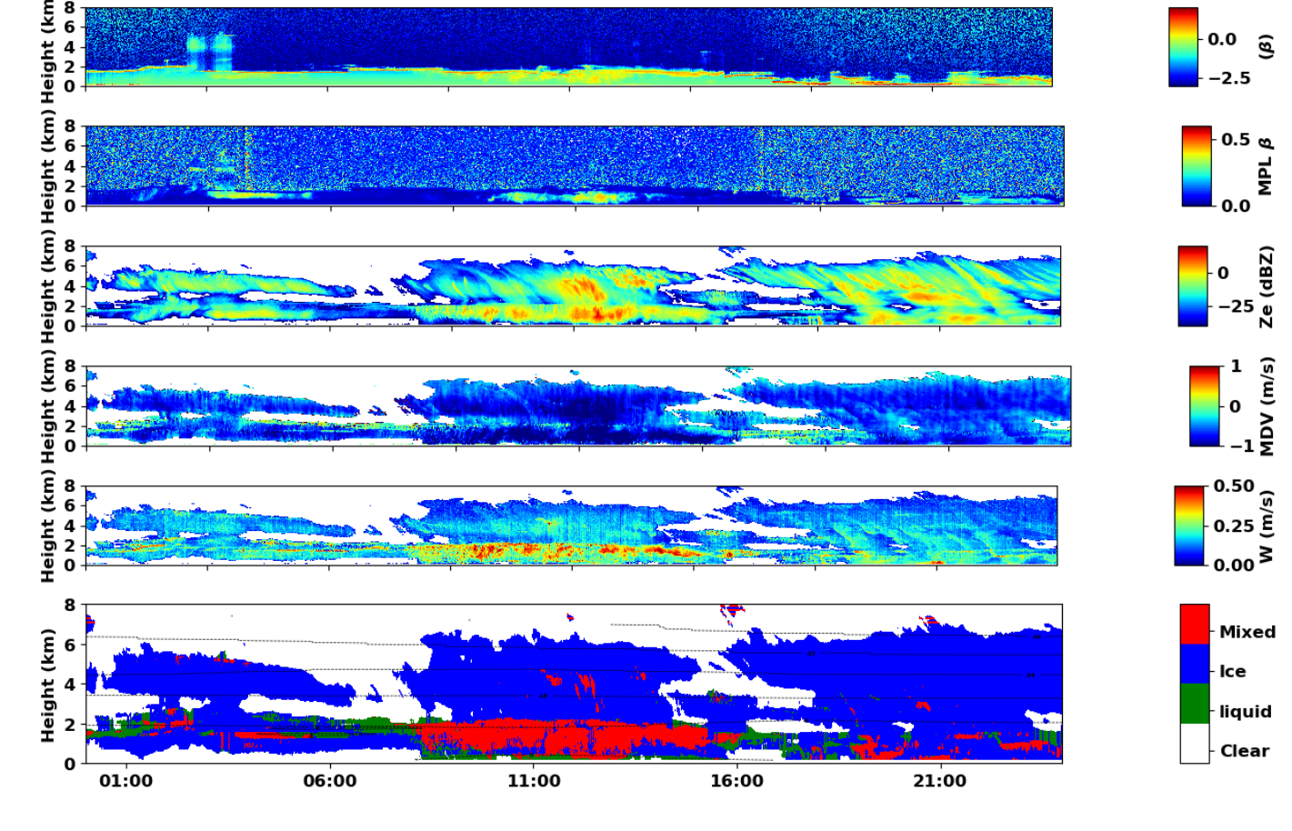
Instrument Data
Threshold algorithm
Notes:
- 1st two are LIDAR
- Next 3 are RADAR
-iso lines are temperature from a radiosonde
- colors in the last plot represent an algorithm which takes this data and predicts cloud phase

Slide 9
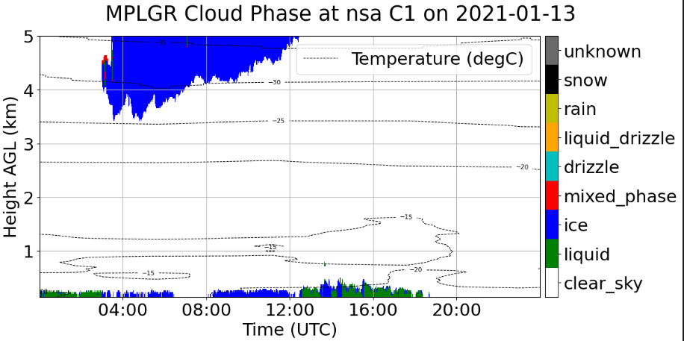

Hand Labeling Data
Original Data
Modified Data

Slide 10
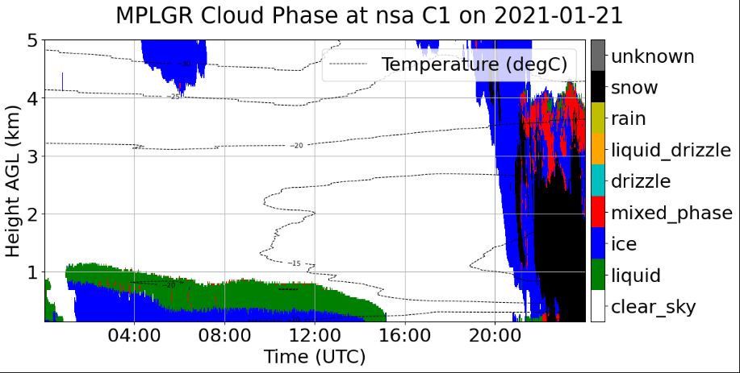
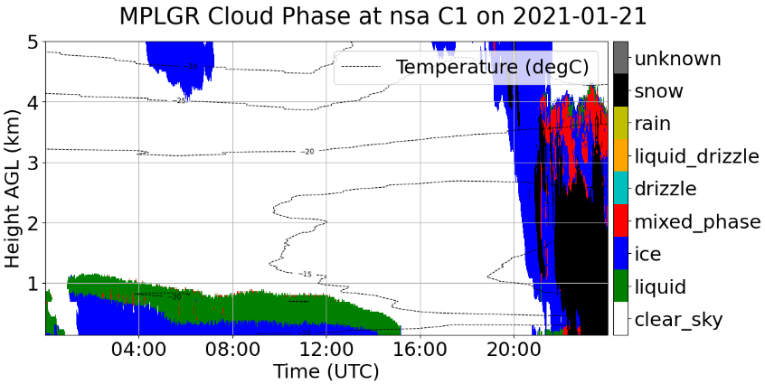
Original Data
Modified Data
Notes:
- Physics of ice formation and polar stratus clouds
-polar—North pole
- stratus—low flat clouds
- non convective(how air circulates the cloud)
- water vapor preferentially condences into water vs ice. So even in cold regions like the artic you get liquid cloud and it transitions to an ice cloud as the droplet falls

Slide 11
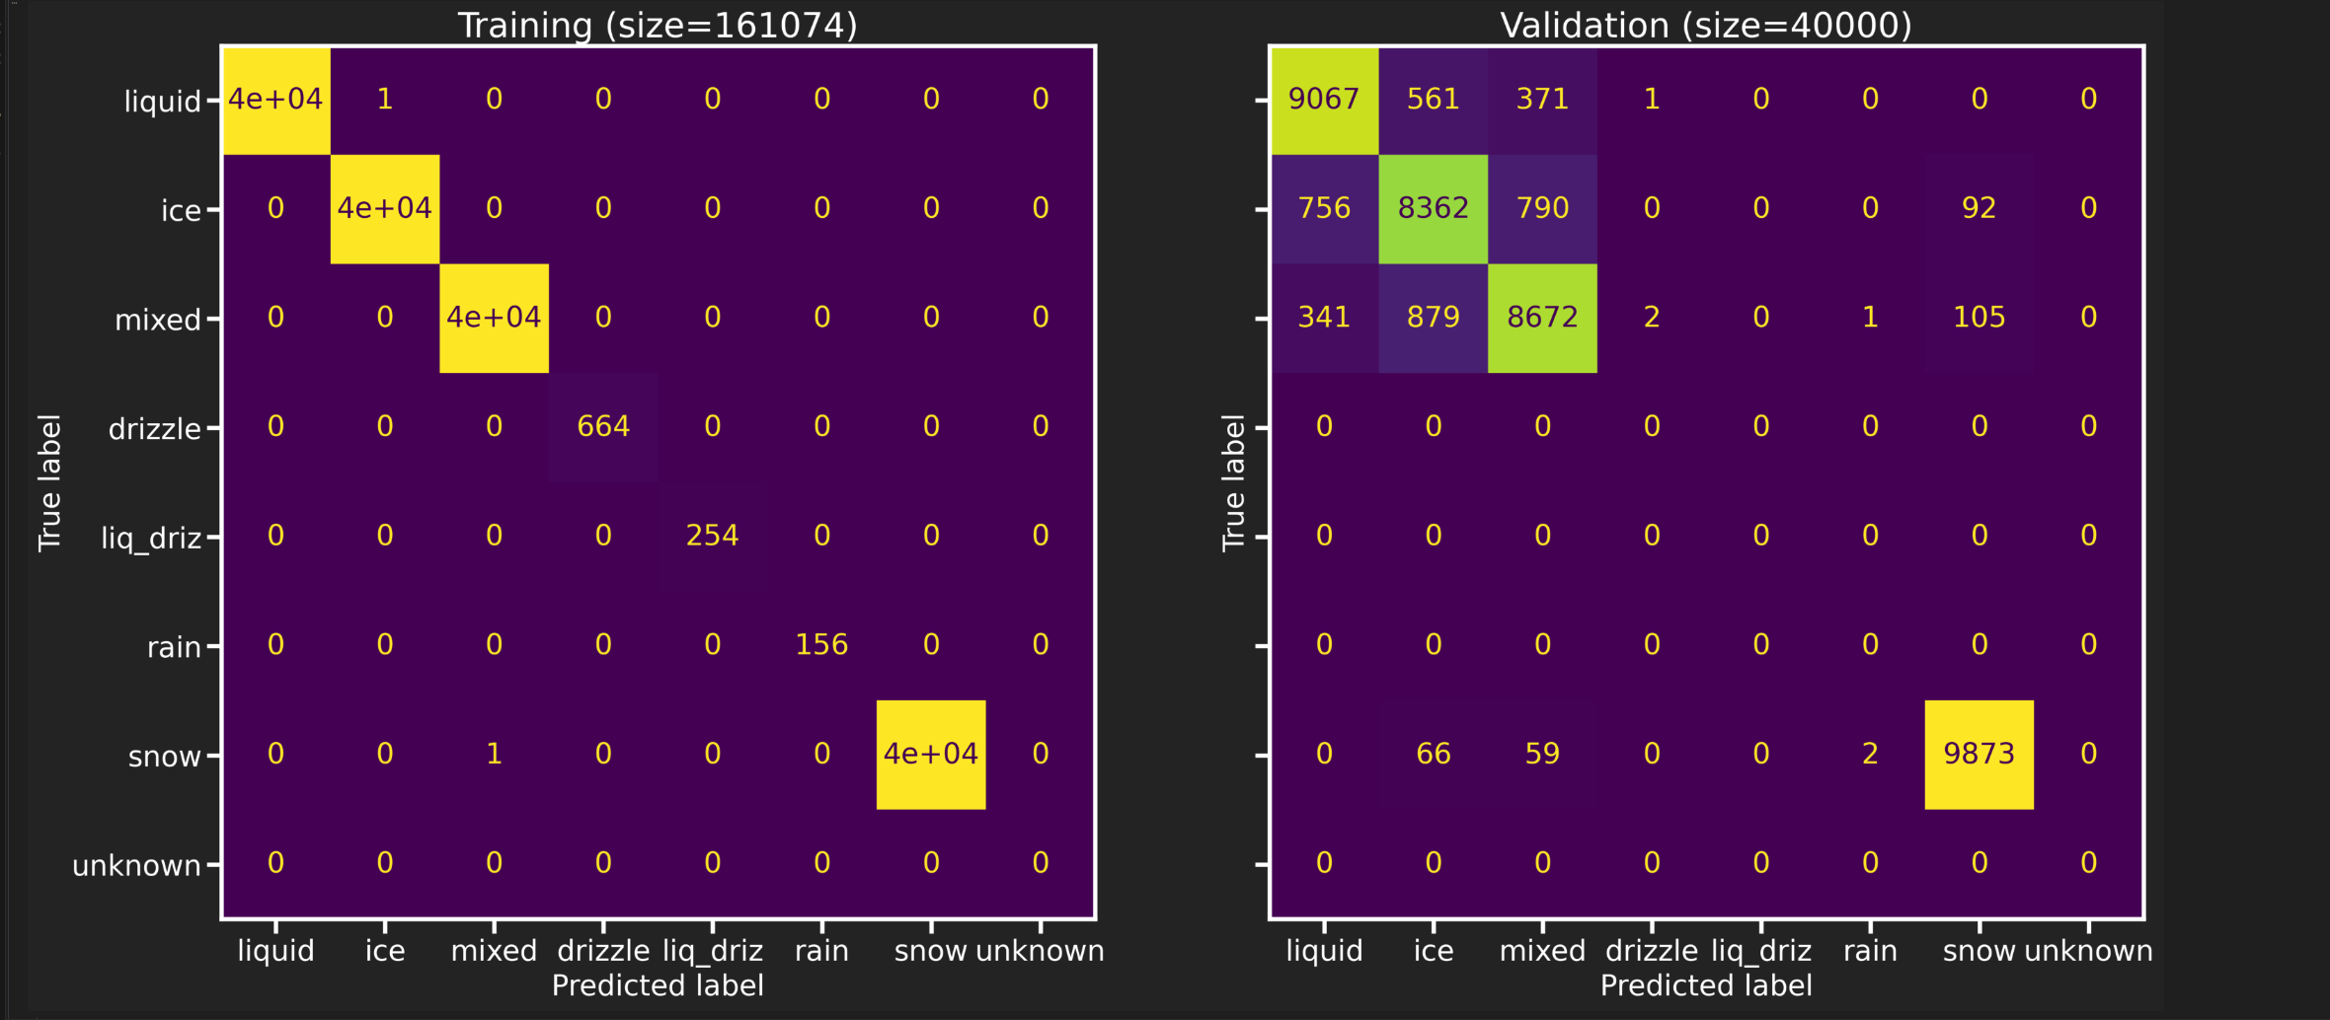
Controlled Random Forest Model (original data)
 | Precision | Recall | F1-score | Support
Drizzle | 0.000 | 0.000 | 0.000 | 0
Ice | 0.847 | 0.836 | 0.842 | 10000
Liquid | 0.892 | 0.907 | 0.899 | 10000
Mixed | 0.877 | 0.867 | 0.872 | 10000
Rain | 0.000 | 0.000 | 0.000 | 0
Snow | 0.980 | 0.987 | 0.984 | 10000
Accuracy |  |  | 8.999 | 40000
Macro Avg | 0.599 | 0.600 | 0.599 | 40000
Weighted Avg | 0.899 | 0.899 | 0.899 | 40000
Training Accuracy=99.999%
Validation Accuracy=89.935%

Slide 12
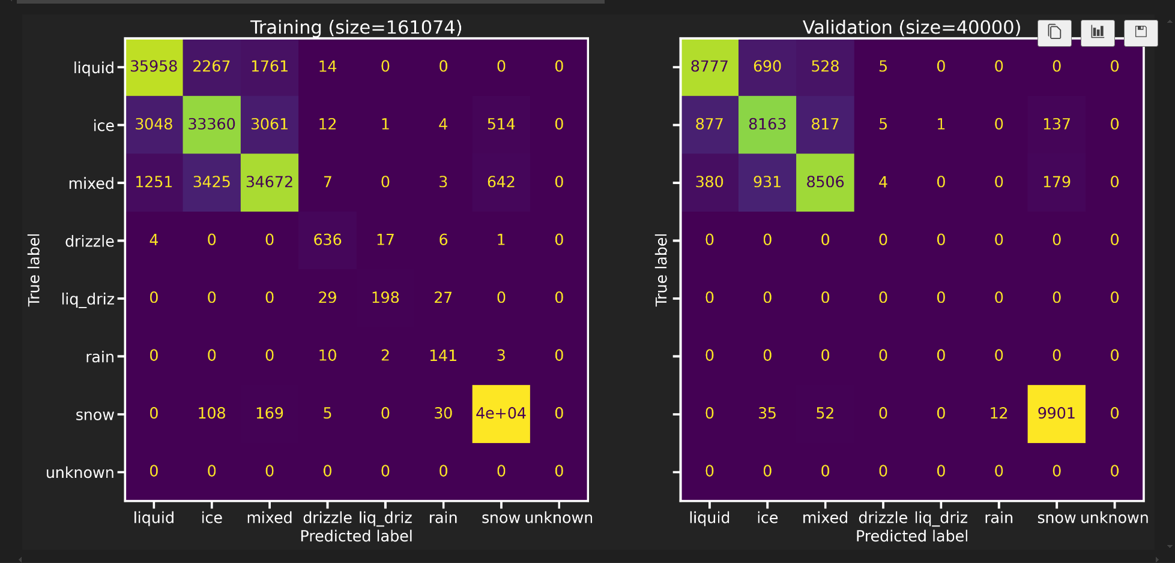
Experimental Random Forest Model(Edited data)
 | Precision | Recall | F1-score | Support
Drizzle | 0.000 | 0.00 | 0.000 | 0
Ice | 0.831 | 0.816 | 0.824 | 10000
Liquid | 0.875 | 0.878 | 0.876 | 10000
Mixed | 0.859 | 0.851 | 0.855 | 10000
Rain | 0.000 | 0.000 | 0.000 | 0
Snow | 0.969 | 0.990 | 0.979 | 10000
Accuracy |  |  | 0.899 | 40000
Macro Avg | 0.599 | 0.600 | 0.599 | 40000
Weighted Avg | 0.899 | 0.899 | 0.899 | 40000
Training Accuracy=99.999%
Validation Accuracy=89.935%
Notes:
-add remaining sections to table

Slide 13
Random Forest Model

Slide 14
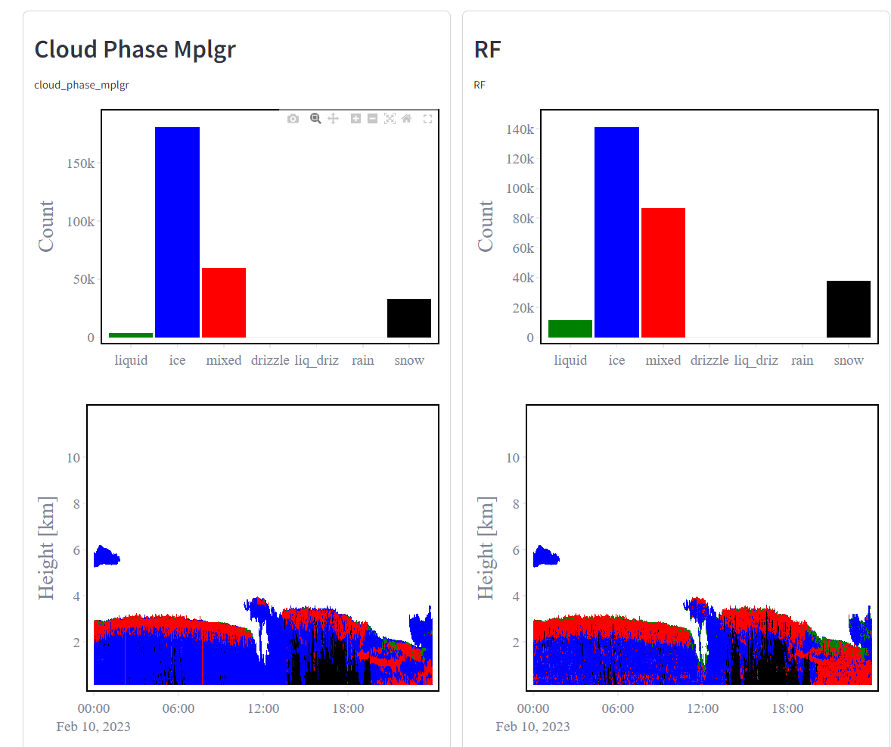
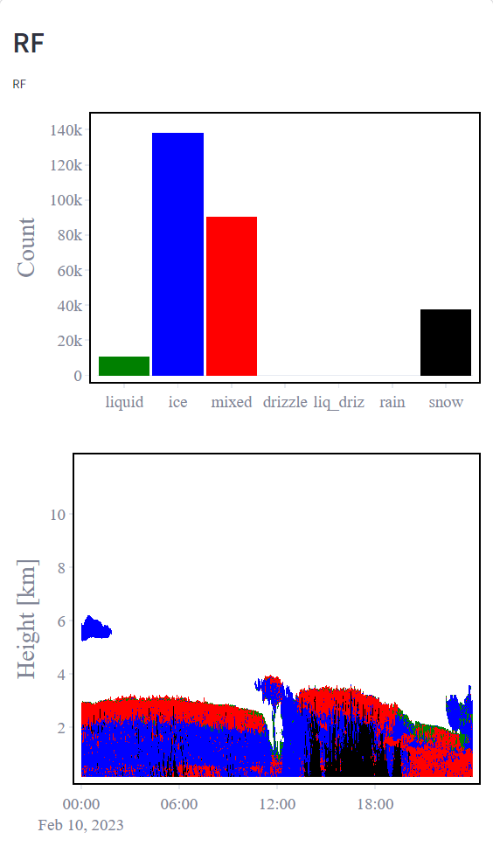
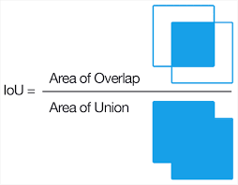
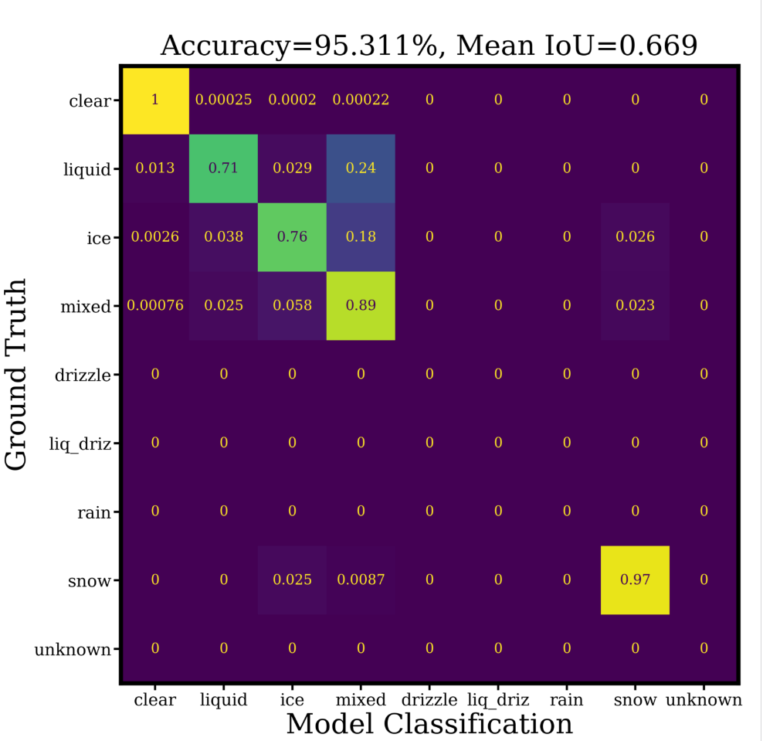
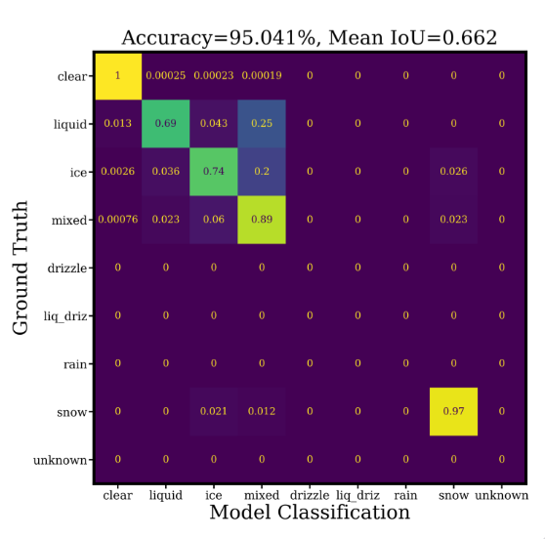
Sample Test Result
Ground Truth=Thermocld phase VAP
Controlled Model
Experimental Model
Notes:
-Experiment model (feb 10^{th, 2023)}
⁻
-both models have speckled data. I think this was because there was not enough data train on. I was limited due to time, which is why I only hand labeled 2 months
- in the future I would label more months for model training
-brighter colors along diagonal mean it is preforming better
-accuracy is not a good measurement because it is biased by clear sky pixels because there are more

Slide 15
Test Data Results
Date | Experimental Model Accuracy | Experimental Model Mean IOU | Control Model Accuracy | Control Model Mean IOU
February 10th, 2023 | 95.041% | 0.662 | 95.311% | 0.669
February 11th, 2023 | 97.433% | 0.659 | 97.353% | 0.654
February 12th, 2023 | 99.868% | 0.465 | 99.853% | 0.456
February 13th, 2023 | 99.311% | 0.516 | 99.308% | 0.508
February 14^{th,} 2023 | 99.039% | 0.639 | 99.032% | 0.639
February 15th , 2023 | 98.820% | 0.770 | 98.893% | 0.625
February 16th , 2023 | 97.933% | 0.582 | 97.915% | 0.580
February 17th ,2023 | 97.376% | 0.628 | 97.489% | 0.632
Notes:
-above a .5 is good iou
-iou(Intersection over union)
-there is not a significant difference between experiment and controlled
- column with more highlighted values for iou preformed better

Slide 16
Conclusion
Why this is important
Understanding cloud phase and how it contributes to climate change: clouds can have a warm or cooling effect
Model is only as good as the data it is trained on

